Slide 1
Single Cycle Processor
Gyaan Antia Cameron Brown Alexandra Day
CE 361 Fall 2021

Slide 2
Table of Contents
Usage Instructions
Control Signals
Traces
Sort_corrected_branch.dat
unsigned_sum.dat
bills_branch.dat
Selected Schematics
Partial Routing Diagram
Design Decisions
Problems and Solutions

Slide 3
Usage Instructions
To launch the simulation, from within the project directory, launch the following shell script:
#!/bin/sh
xrun -64bit -gui -access r test/processor_tb.v extralib/*/* src/*
To change the test file, within src/processor.v, change the argument for parameter memory_file:

Slide 4
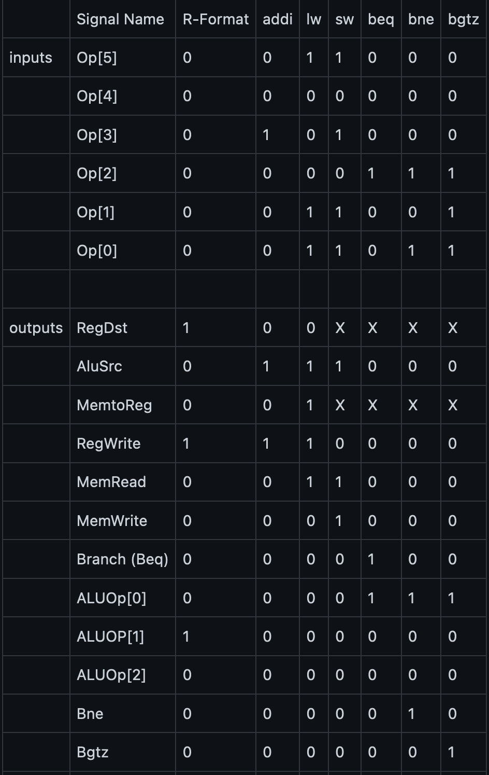
Control Signals

Slide 5
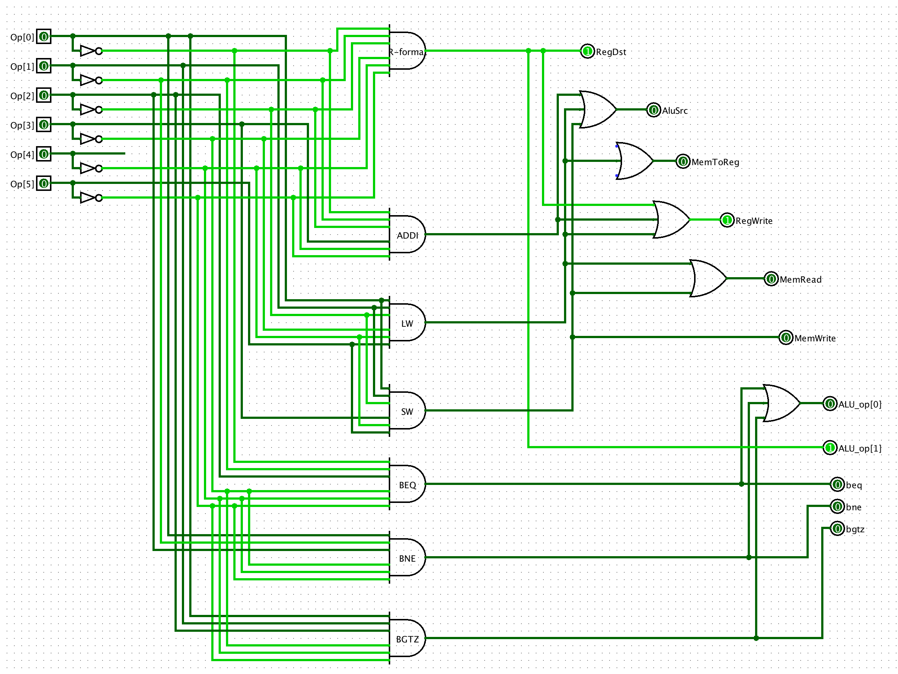

Slide 6
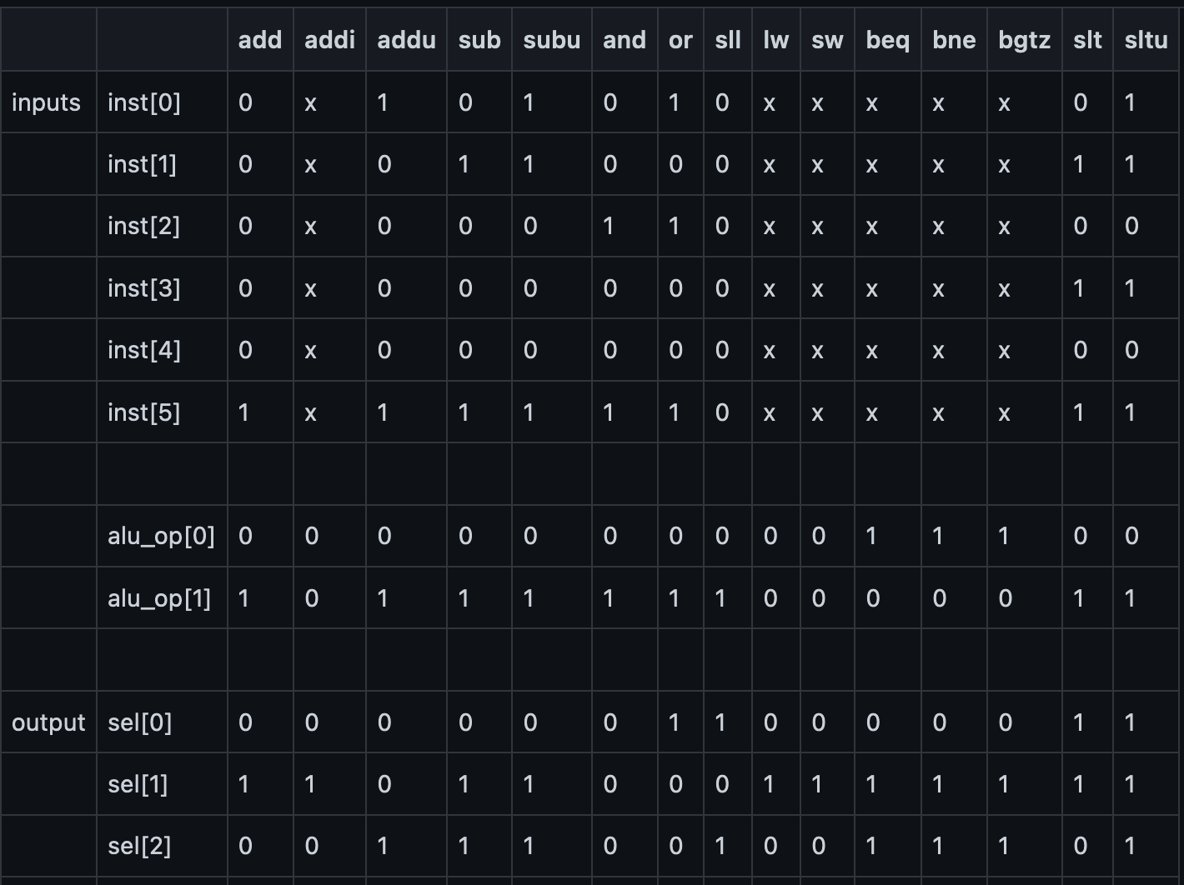
ALU Control

Slide 7
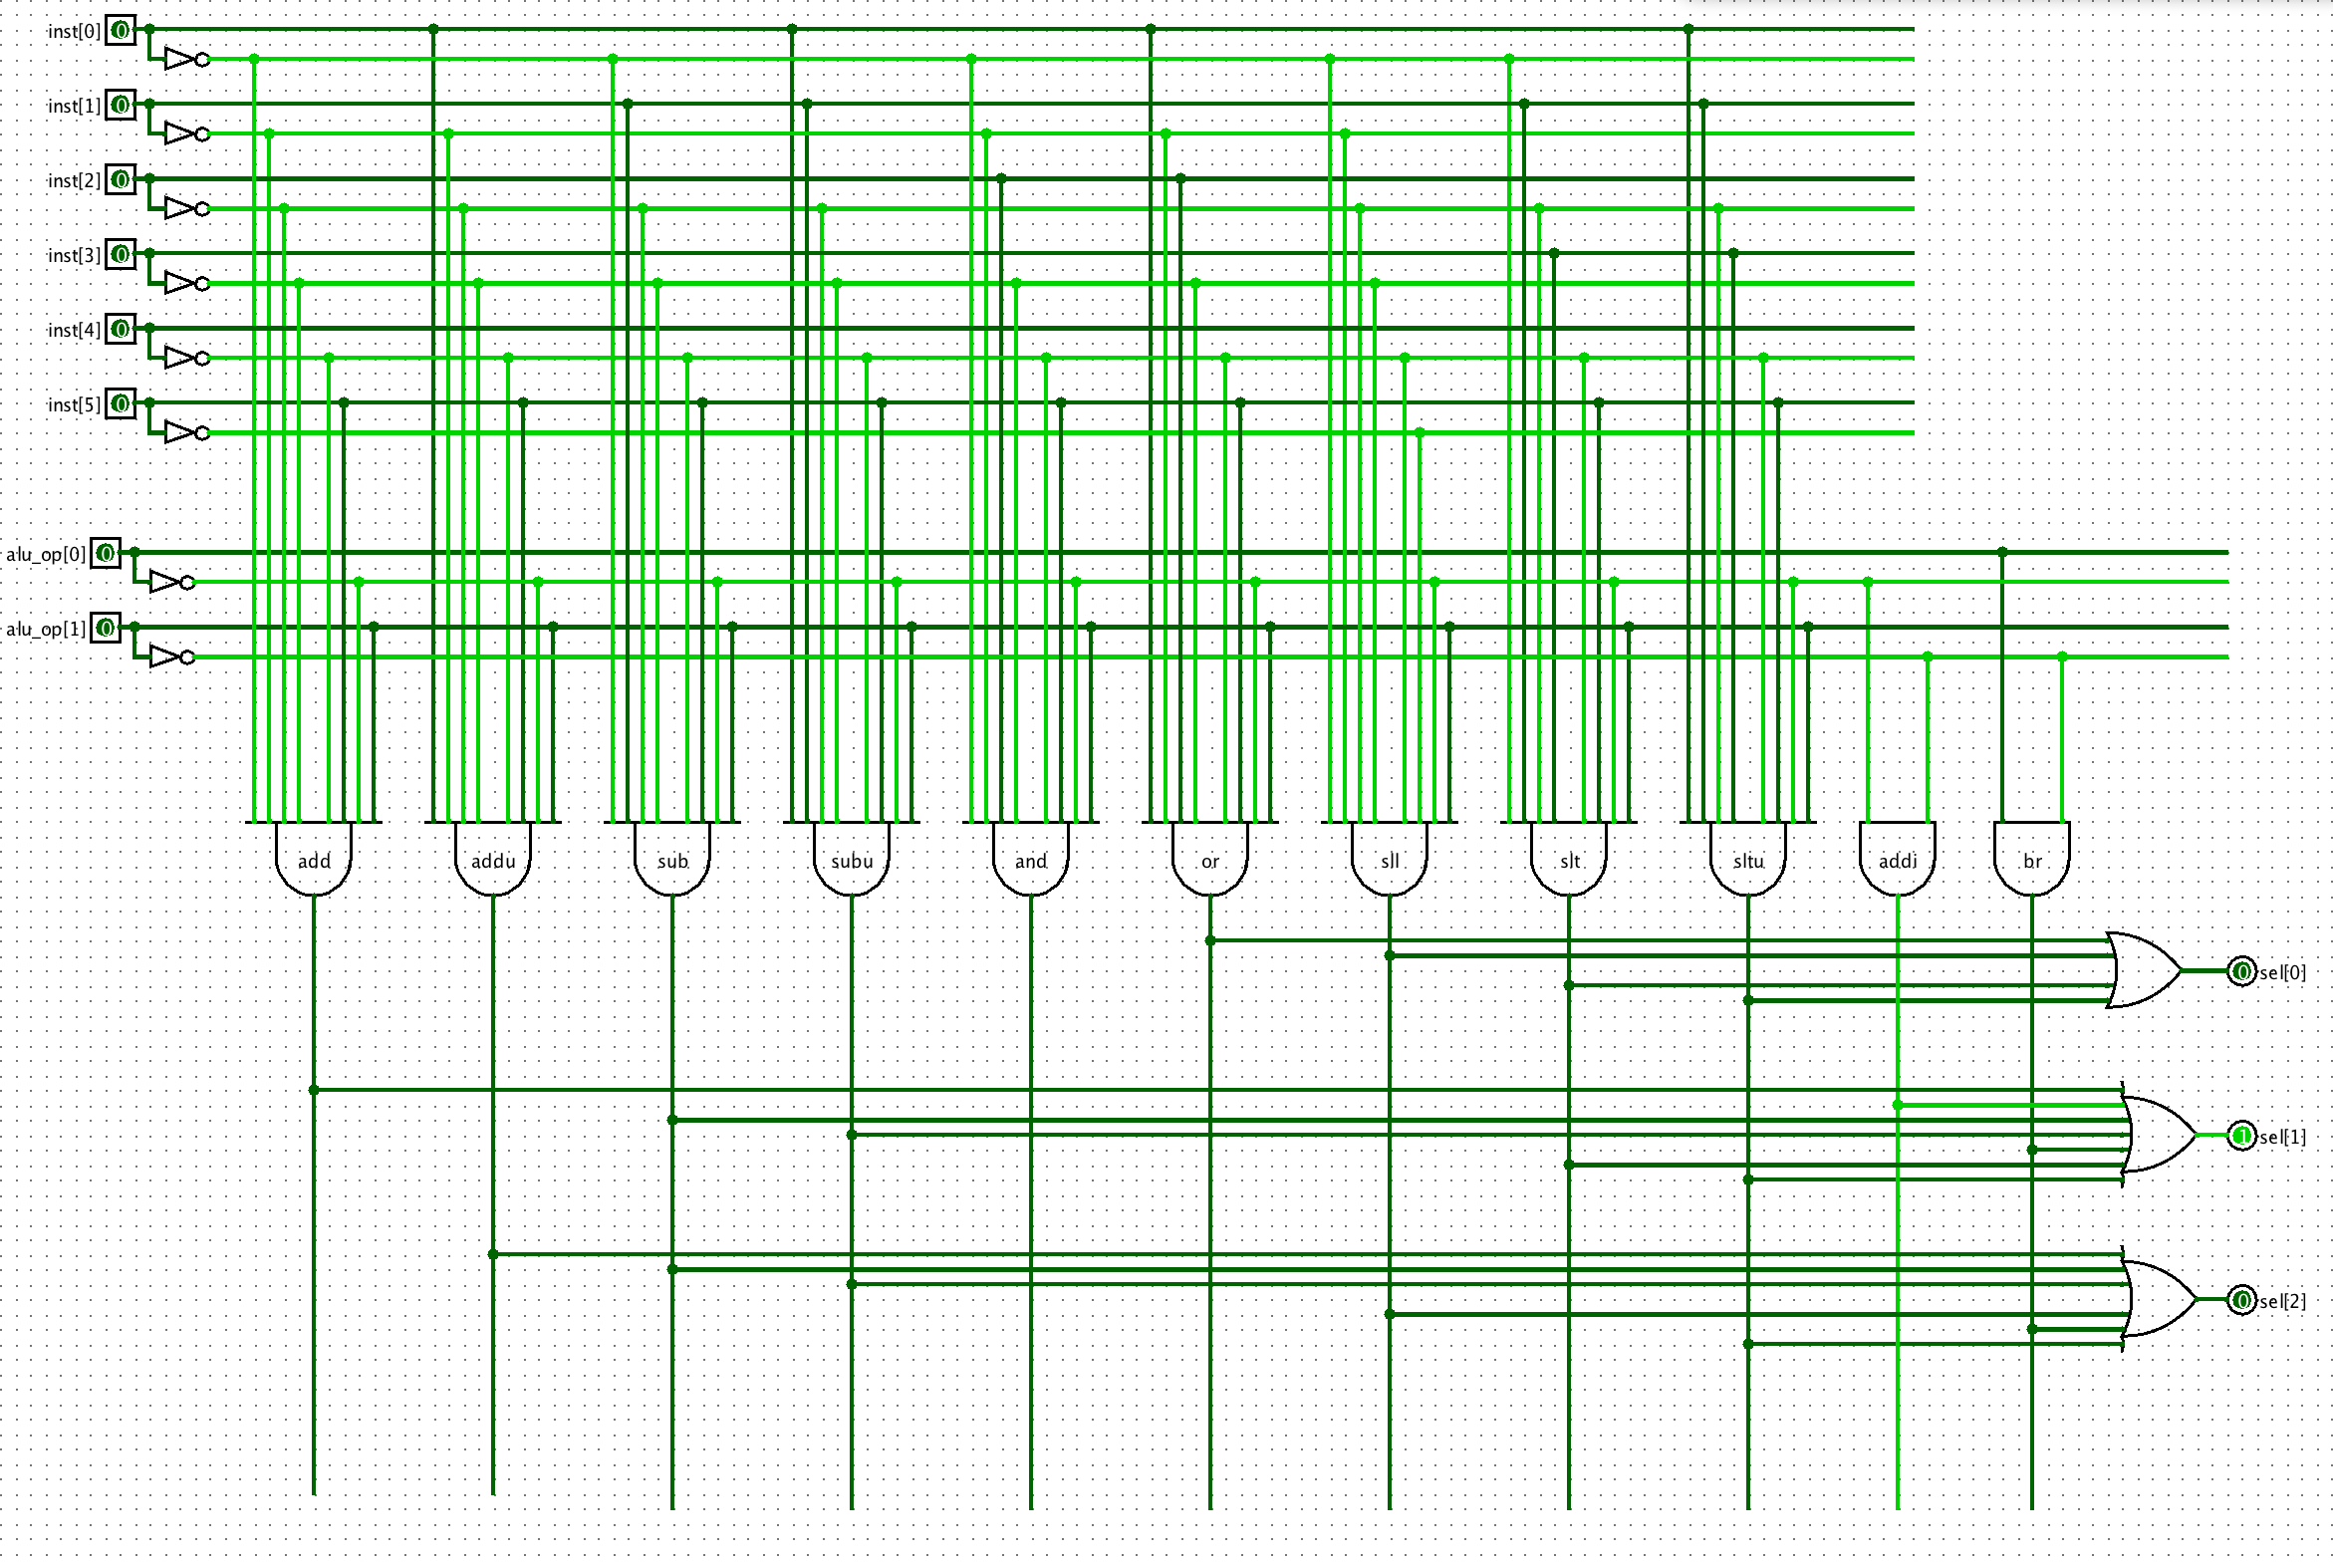

Slide 8
Traces Overview
The first few hundred ps of each program execution is shown, along with the final output for each program.

Slide 9
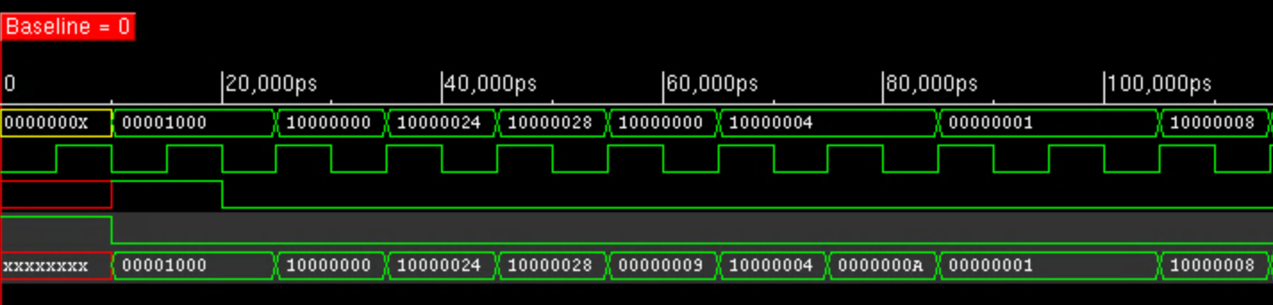
Traces – sort_corrected_branch.dat (I)

Slide 10
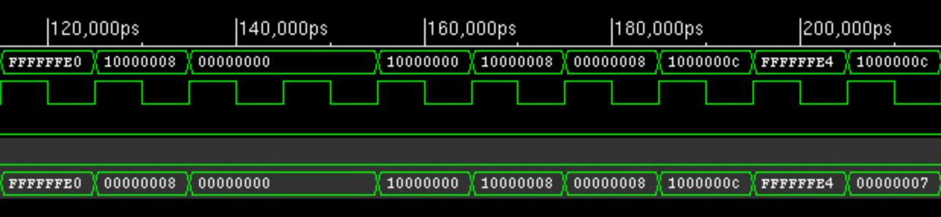
Traces – sort_corrected_branch.dat (II)

Slide 11
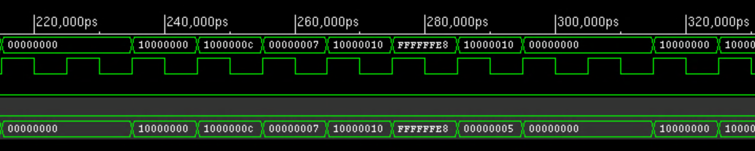
Traces – sort_corrected_branch.dat (III)

Slide 12
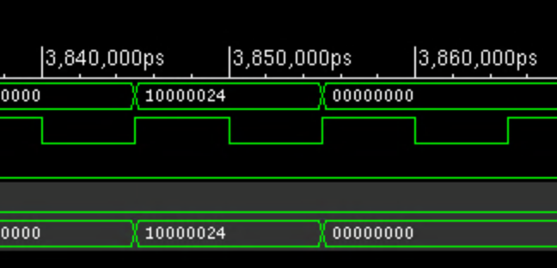
Traces – sort_corrected_branch.dat Final Output

Slide 13
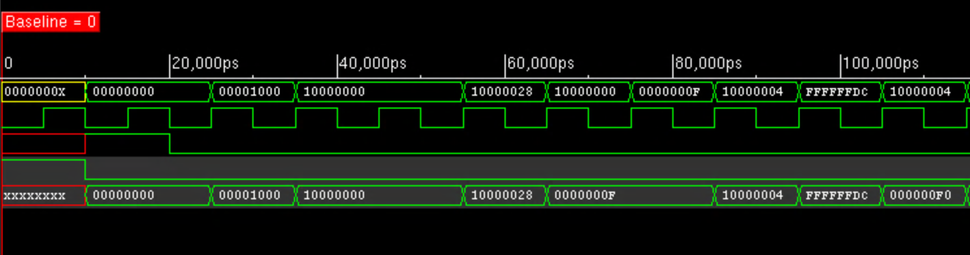
Traces – unsigned_sum.dat (I)

Slide 14
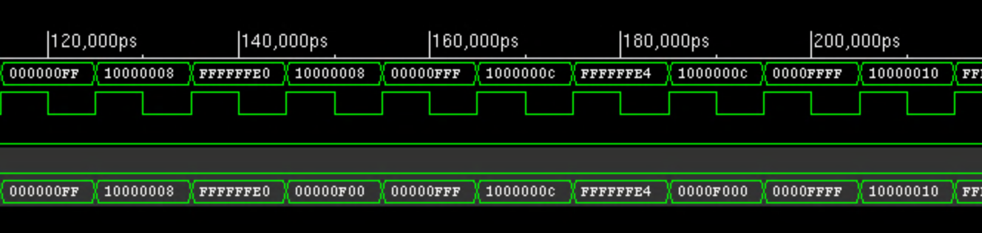
Traces – unsigned_sum.dat (II)

Slide 15
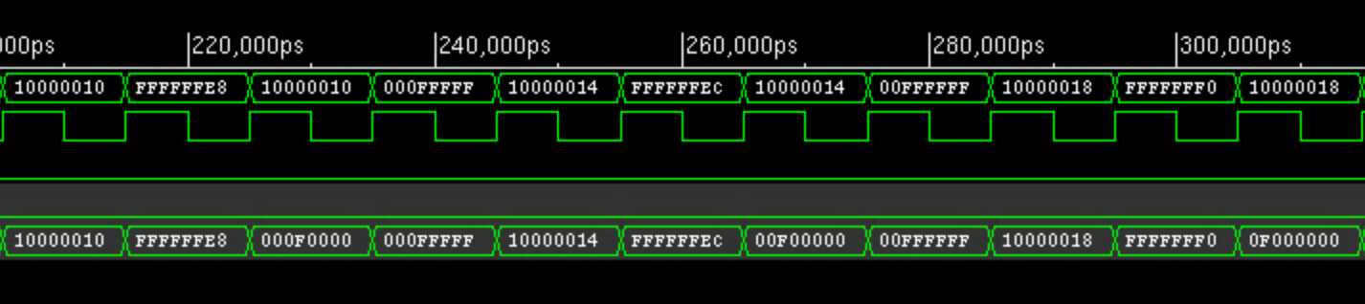
Traces – unsigned_sum.dat (III)

Slide 16
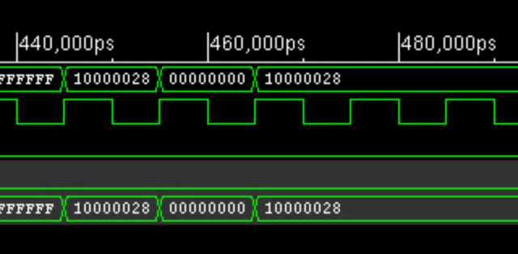
Traces – unsigned_sum.dat Final Output

Slide 17
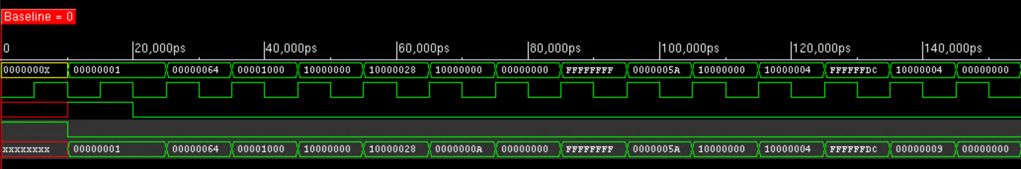
Traces – bills_branch.dat (I)

Slide 18
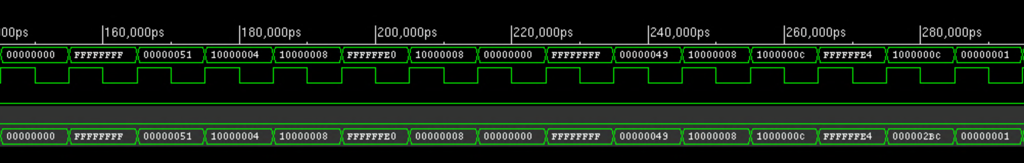
Traces – bills_branch.dat (II)

Slide 19
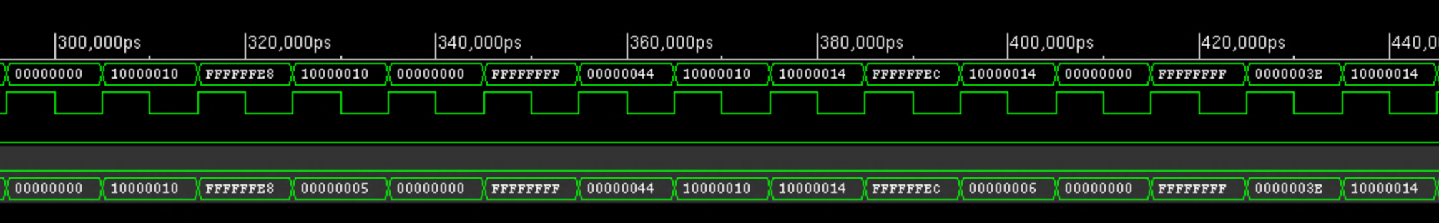
Traces – bills_branch.dat (III)

Slide 20
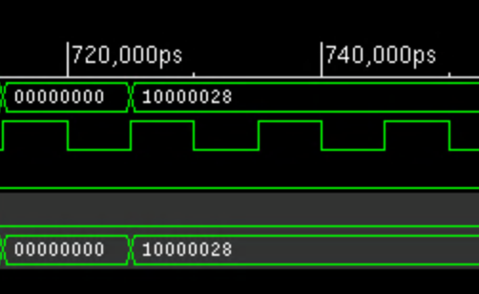
Traces – bills_branch.dat Final Output

Slide 21
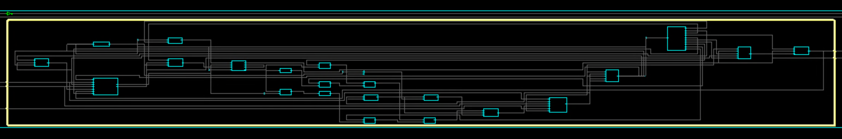
Overall Processor Schematic

Slide 22
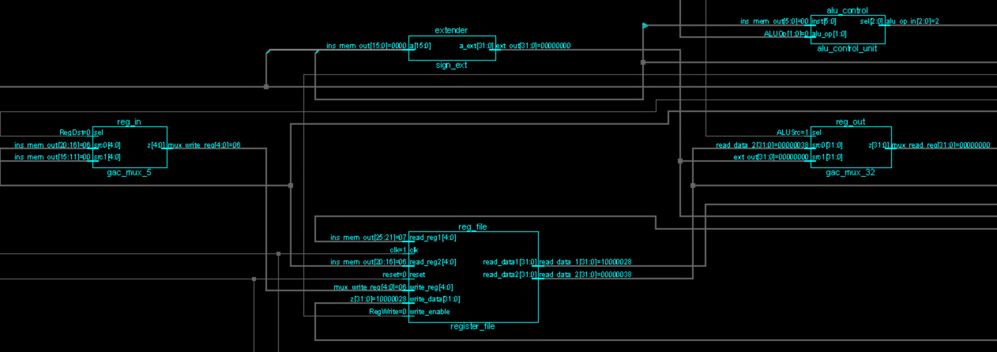
Overall Schematic Detail – 1

Slide 23
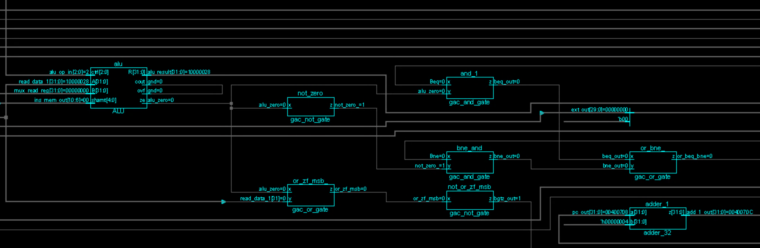
Overall Schematic Detail – 2

Slide 24
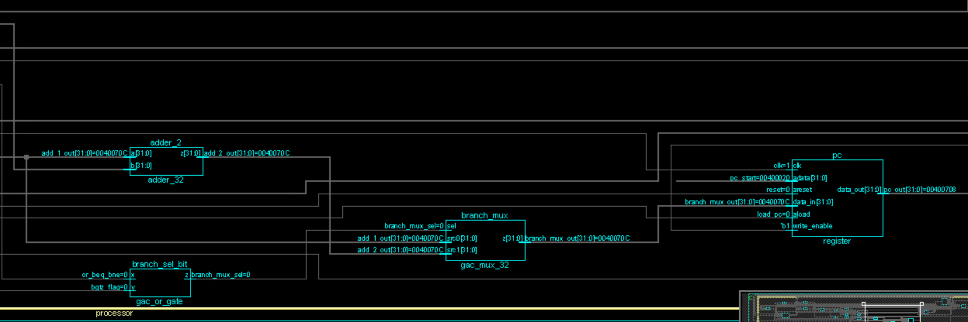
Overall Schematic Detail – 3

Slide 25
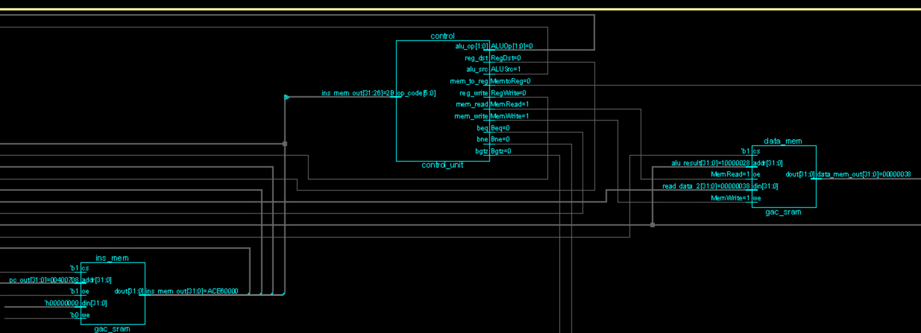
Overall Schematic Detail – 4

Slide 26
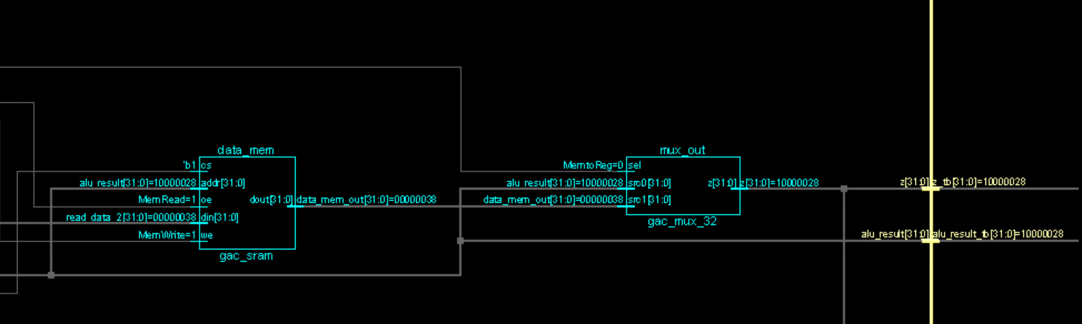
Overall Schematic Detail – 5

Slide 27
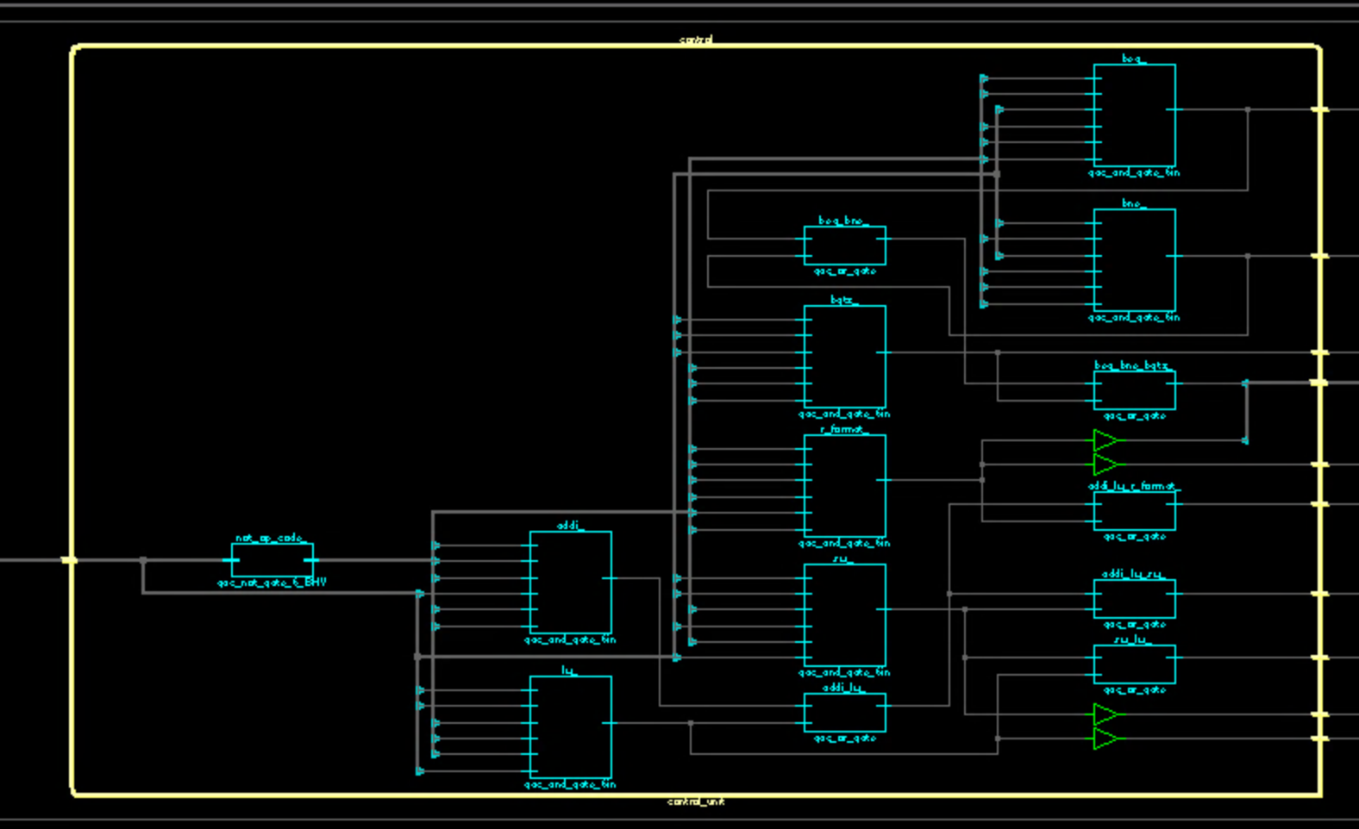
High-Level Control Unit Schematic

Slide 28
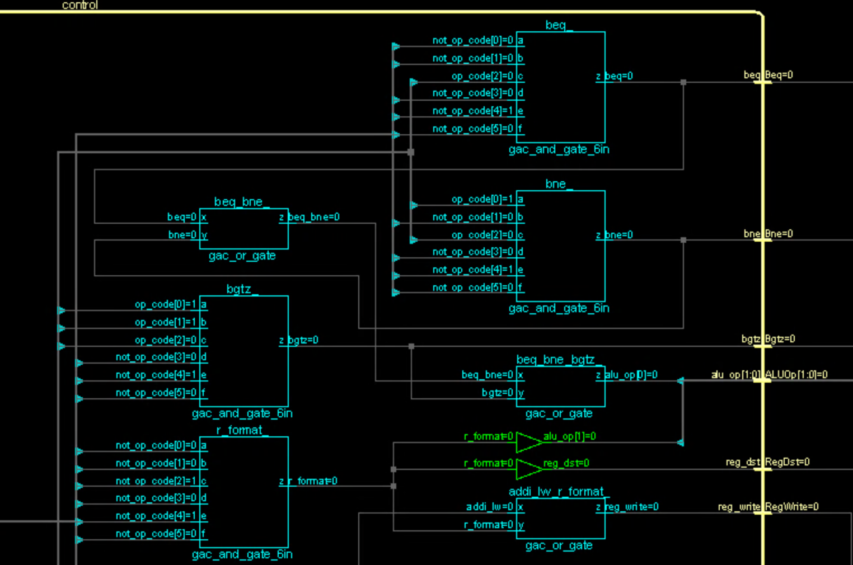
Control Unit Detail
Image cropped for readability.

Slide 29
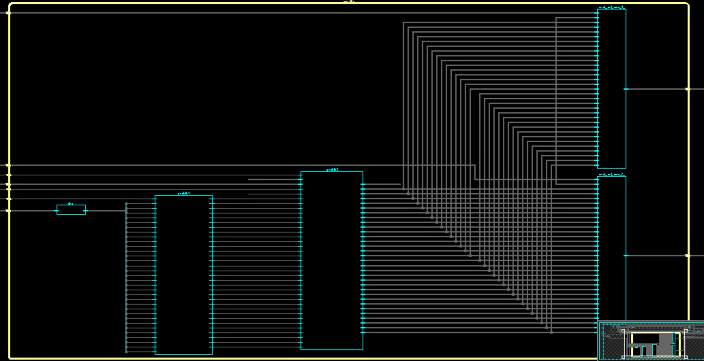
High-Level Register File Schematic

Slide 30
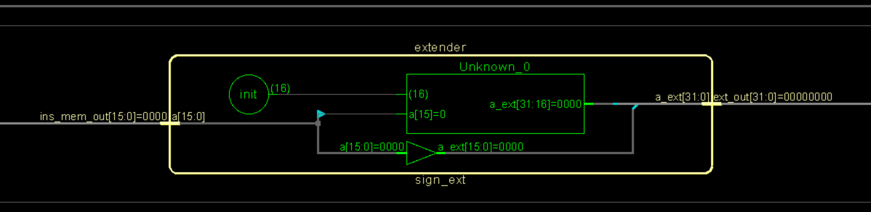
Detail of Sign Extender

Slide 31
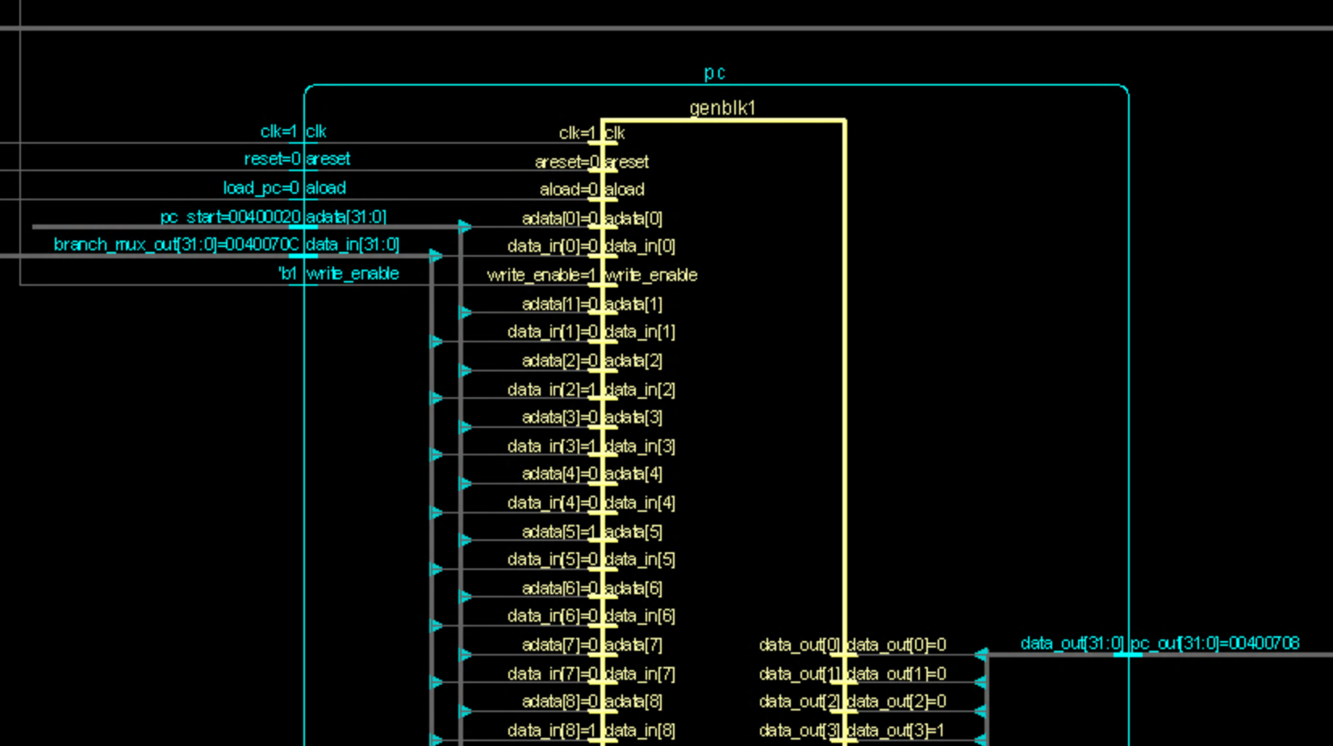
Partial Schematic of Program Counter (PC)
Our PC is essentially an instantiation of one of our registers, so this design shows our register as well. Image cropped for readability.

Slide 32
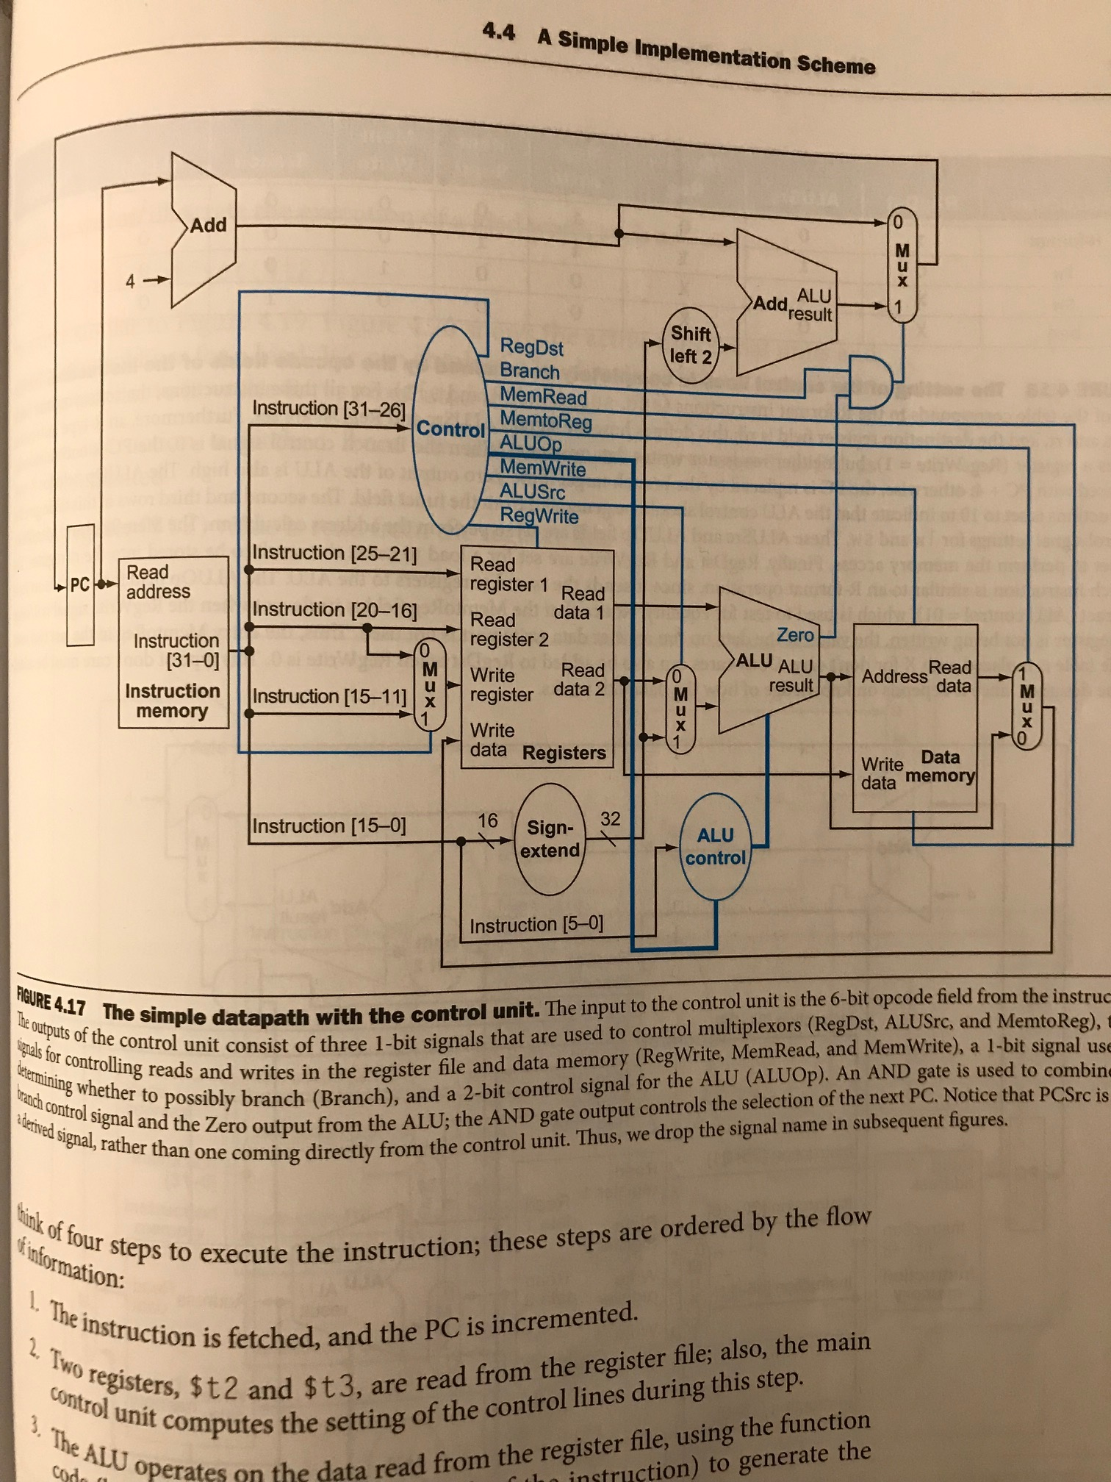
Partial Routing Diagram: shows all wires except for those supporting bne, bgtz
Add_1_out
branch_mux_out
Add_2_out
branch_mux_sel
Alu_zero
Read_data_1
Read_data_2
Notes: the diagram is from Computer Organization and Design, p. 265, by Patterson and Hennessy; wire names are case-insensitive relative to our circuit
Data_mem_out
Pc_out
Alu_result
Ins_mem_out
Mux_write_reg
Mux_read_reg
Alu_op_in
z
Ext_out

Slide 33
Design Decisions (I)
We largely followed the book’s design for the single-cycle processor on p. 265.
We relied on the provided ALU, adders, small gates and SRAM; we designed, built and tested our own:
Control (both main and ALU)
Registers
Register file
Sign extender
Program counter
We implemented both of our control units using a PLA
We added additional logic to support the bne and bgtz instructions

Slide 34
Design Decisions (II)
We considered using VHDL but stuck with Verilog because we all had experience with Verilog from 303 and have heard that it is easier to debug.
We considered using one of our own ALUs after we realized the provided ALU was difficult to use; however, we kept the provided ALU after realizing that it already came with a control unit (even though we eventually abandoned the ALUCU because it didn’t work and just made a PLA).
We built our design in a modular fashion, using testbenches to validate small components as we went along. This technique saved us time debugging later. For example, we built the instruction fetch module based on Figure 4.6 in the book, which was helpful for debugging our full circuit.
For rigorous testing, we used the provided functions to simulate the demo environment.

Slide 35
Problems and Solutions (I)
The greatest issue we encountered was lack of documentation for the “off-the-shelf” components and the fact that many of them did not compile or work properly.
We spent considerable time figuring out the control signals for the ALU we were given
We had to modify many of the provided Verilog files to get them to compile
In a few cases, we needed to make new library components for our design:
6-input AND gates
2x32-bit mux with 1-bit selector, 32x32-bit mux with 5-bit selector

Slide 36
Problems and Solutions (II)
For debugging, we benefitted from using the Xcelium schematic viewer, which allowed us to trace signals.
During debugging, we also realized that many errors would “propagate” through the circuit because the output signals route back into earlier stages of the design. We hard-coded these signals for debugging to discover the root of the issue. For example, the output of the top mux in Figure 4.17 feeds back into the PC, so we disconnected that wire for debugging and reconnected it at the end.
We encountered issues with the provided syncram, which we had been using for the data memory. We eventually replaced the syncram with sram for the data memory and our design worked.

